Slide 1
Lecture 19 – Anonymity
Michael Bailey
University of Illinois
ECE 422/CS 461 – Spring 2016

Slide 2

Anonymity

Slide 3
Why Privacy?
Privacy is not equivalent to secrecy
Necessary to ensure civil liberties:
Free speech, free association, autonomy, freedom from censorship and constant surveillance
"Nothing to Hide Argument"
Dangers of constructing a Kafkaesque world
Optional reading: 'I've Got Nothing to Hide' and Other Misunderstandings of Privacy, Daniel J. Solove
Notes:
Nothing to Hide argument: used as justification for surveillance, ignores non-secrecy understandings of privacy. Often used to justify surveillance while ignoring the potential problems of data aggregation and lack of transparency in information processing.
Privacy very much linked to surveillance. When a dossier of information collected about you, this can be used to construct stories about you. This story may be made up of a series of facts, but the picture it paints not necessarily accurate.

Slide 4
Nymity Spectrum
Verinymity
credit card #s, driver's license, address
Pseudonymity
pen names, many blogs
Linkable anonymity
loyalty cards, prepaid mobile phone
Unlinkable anonymity
paying in cash, Tor
Notes:
1. Nymity is the extent to which identity information disclosed during a session/transaction is linked to a true identity of an entity
2. Verinymity or True Name; any piece of identifying info that can single you out of a crowd of potential candidates
3. Pseudonymity: use of persistent fictitious name, unique enough so that party can be distinguished from other parties, but not so unique as to be tied back to real entity

Slide 5
Understanding Anonymity
"without a name"
Who wants it
How to get it
Threats to it
Notes:
Without a name
Whistleblowers, crime reporting, spies/undercover agents
Consumers/online shoppers, web browsers
Businesses (don’t want competitors spying on their moves –) patent databases’ access.

Slide 6
Anonymity
Anonymity: Concealing your identity
In the context of the Internet, we may want anonymous communications
Communications where the identity of the source and/or destination are concealed
Not to be confused with confidentiality
Confidentiality is about contents, anonymity is about identities

Slide 7
Anonymity
Internet anonymity is hard*
Difficult if not impossible to achieve on your own
Right there in every packet is the source and destination IP address
* But it’s easy for bad guys. Why?
You generally need help
State of the art technique: Ask someone else to send it for you
Ok, it’s a bit more sophisticated than that...

Slide 8
Proxies
Proxy: Intermediary that relays our traffic
Trusted 3rd party, e.g. ... hidemyass.com
You set up an encrypted VPN to their site
All of your traffic goes through them
Why easy for bad guys? Compromised machines as proxies.

Slide 9
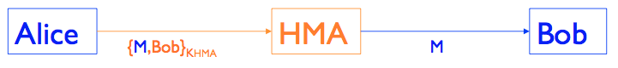
Alice wants to send a message M to Bob ...
Bob doesn’t know M is from Alice, and
Eve can’t determine that Alice is indeed communicating with Bob.
HMA accepts messages encrypted for it. Extracts destination and forwards.

Slide 10

Anonymity motivation
Surveillance under:
The Patriot Act
Section 215
National Security Letters (NSLs)
FISA Amendment Act
Notes:
-Section 215: authorizes the government to obtain "any tangible thing" relevant to a terrorism investigation, even if there is no showing that the "thing" pertains to suspected terrorists or terrorist activities.
- NSLs permit the government to obtain the communication, financial and credit records of anyone deemed relevant to a terrorism investigation even if that person is not suspected of unlawful behavior.
-FISA Amendment Act (2008)
----broad power to intercept american communications abroad
----Amnesty vs. Clapper: filed on behalf of a broad coalition of attorneys and organizations whose work requires them to engage in sensitive and sometimes privileged telephone and email communications with individuals located abroad. But in a 5–4 ruling handed down in February 2013, the Supreme Court held that the ACLU plaintiffs did not have standing to sue because they could not prove their communications had actually been surveilled under the law.
---United States v. Muhtorov, Jan 2014. Muhtorov first criminal defendant to receive notice he was surveilled under FAA.

Slide 11
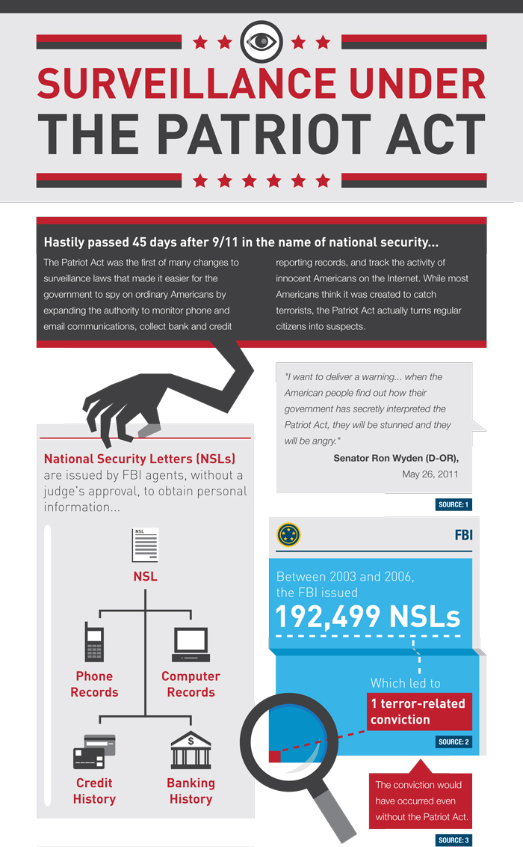
Image credit: ACLU
Notes:
Image credit http://www.aclu.org/files/mm_images/patriot_infographic_full.jpg
Patriot act allows FBI to get access to email without warrants
Plenty of evidence this is currently abused (drug related searches vs terrorism?)

Slide 12
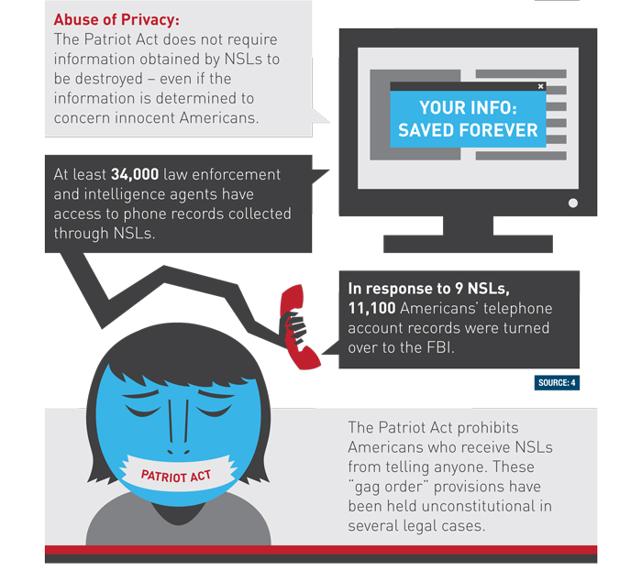
Surveillance under the PATRIOT Act
Image credit: ACLU

Slide 13
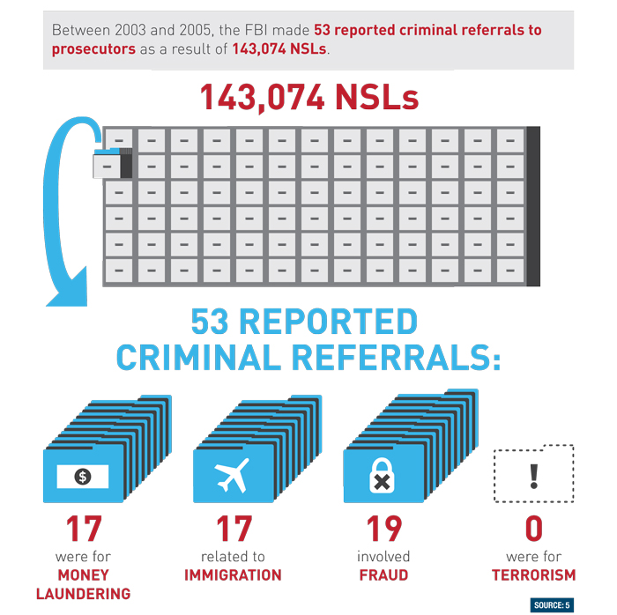
Surveillance under the PATRIOT Act
Image credit: ACLU
Notes:
Image credit http://www.aclu.org/files/mm_images/patriot_infographic_full.jpg
Recall anonymity as an enforcement of privacy (if the gov’t won’t do it, let’s make technology do it)

Slide 14
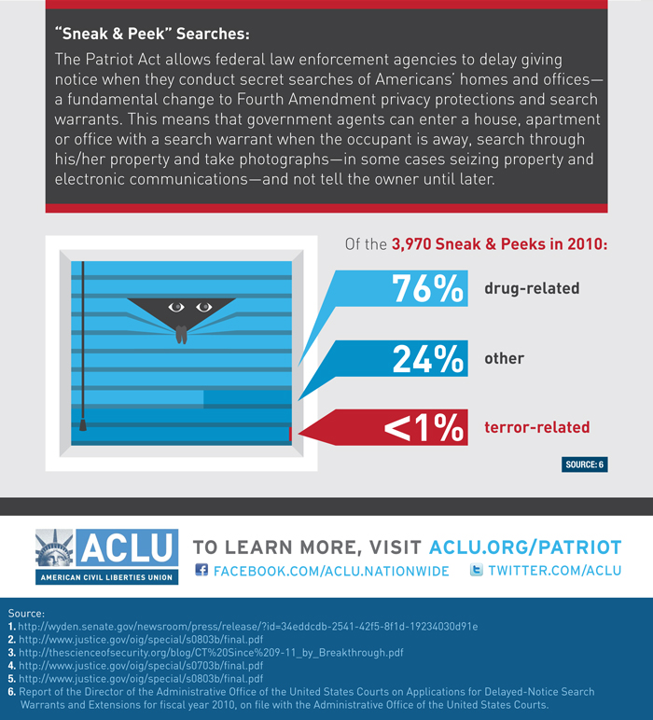
Surveillance under the PATRIOT Act
Image credit: ACLU

Slide 15
Google Transparency Report
National Security Letters (NSLs)
Reporting Period National Security Letters Users/Accounts
July to December 2014 0–999 0–999
January to June 2014 0–999 0–999
July to December 2013 0–999 1000–1999
January to June 2013 0–999 0–999
July to December 2012 0–999 0–999
January to June 2012 0–999 1000–1999
July to December 2011 0–999 0–999
January to June 2011 0–999 0–999
July to December 2010 0–999 1000–1999
January to June 2010 0–999 1000–1999
July to December 2009 0–999 0–999
January to June 2009 0–999 0–999

Slide 16
Google Foreign Intelligence Surveillance Act (FISA) Requests
Non-content FISA requests
Reporting Period Number of requests Users/Accounts
July to December 2014 Data subject to six month reporting delay
January to June 2014 0–999 0–999
July to December 2013 0–999 0–999
January to June 2013 0–999 0–999
July to December 2012 0–999 0–999
January to June 2012 0–999 0–999
July to December 2011 0–999 0–999
January to June 2011 0–999 0–999
July to December 2010 0–999 0–999
January to June 2010 0–999 0–999
July to December 2009 0–999 0–999
January to June 2009 0–999 0–999
Notes:
Facebook, Apple also publish Transparency Reports
Apple's initial section 215 Patriot Act Transparency report (2013) included a warrant canary: "Apple has never received an order under Section 215 of the USA Patriot Act. We would expect to challenge such an order if served on us"
-This disappeared in latest report, covering last half of 2013, first half of 2014.

Slide 17
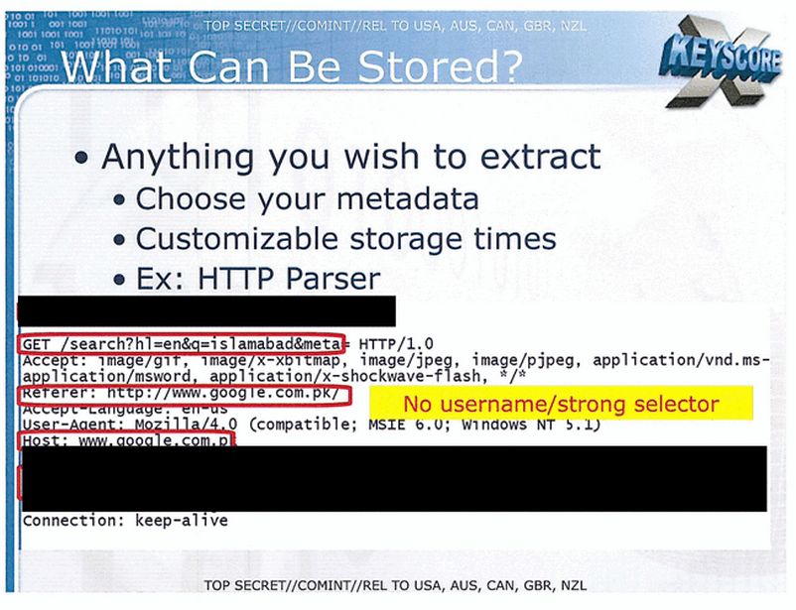
XKEYSCORE
Notes:
The program Snowden referenced when claiming "I, sitting at my desk," said Snowden, could "wiretap anyone, from you or your accountant, to a federal judge or even the president, if I had a personal email".

Slide 18
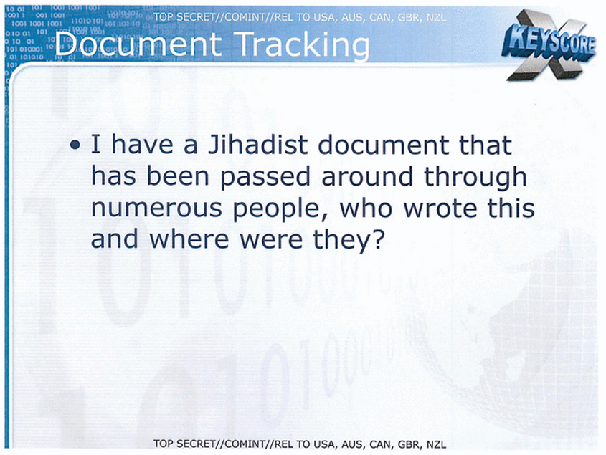
XKEYSCORE

Slide 19

Technology as a defense
Notes:
Policy is not enough to protect abuse; policy has to allow for enforcement/self-protection. E.g. 2nd amendment allows for enforcement against a tyrannical government, but only if government is limited to weapons available to people. Today this is less true…but using technology as a defense can still be effective (e.g. PGP vs NSL, Tor vs XKEYSCORE).

Slide 20
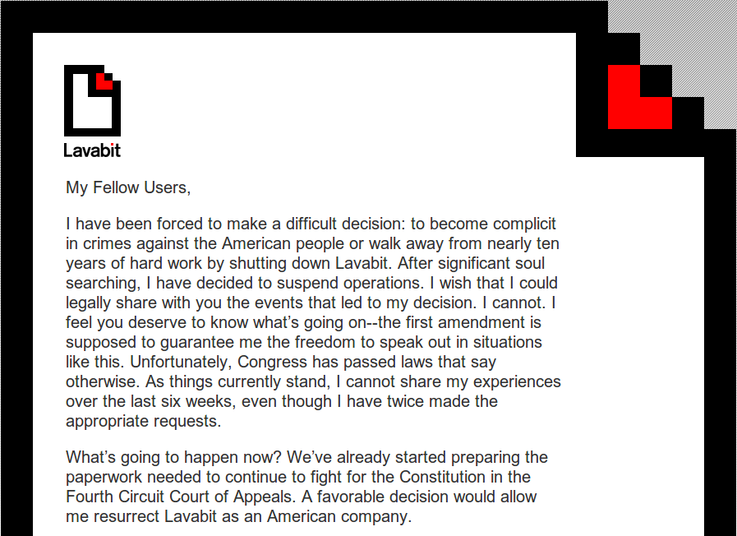
Poor example: Lavabit
Lavabit
Notes:
Lavabit – ed snowden’s email provider (allegedly he used PGP on top of this)

Slide 21






Lavabit
Password
Password
Private key
Private key
Public key
User
Private key
To: user@lavabit
Password
Password
Private key
Private key
User
Notes:
“At account creation time, the user selected a login passphrase and transmitted it to the server.
The server generated a keypair for that user, encrypted the private key with the login passphrase the user had selected, and stored it on the server.
For every incoming email the user received, the server would encrypt it with the user’s public key, and store it on the server.
When the user wanted to retrieve an email, they would transmit their password to the server, which would avert its eyes from the plaintext encryption password it had just received, use it to decrypt the private key (averting its eyes), use the private key to decrypt the email (again averting its eyes), and transmit the plaintext email to the user (averting its eyes one last time).” Moxie Marlinspike

Slide 22
Encryption Tools: PGP
GnuPG, free software
Pretty Good Privacy (PGP), Phil Zimmerman ('91)
Lets you hide email content via encryption
Basic idea:
Hybrid encryption to conceal messages
Digital signatures on messages (hash-then-sign)

Slide 23
PGP cont'd
Each user has:
A public encryption key, paired with a private decryption key
A private signature key, paired with a public verification key
How does sending/receiving work?
How do you find out someone's public key?

Slide 24
Sending and receiving
To send a message:
Sign with your signature key
Encrypt message and signature with recipient's public encryption key
To receive a message:
Decrypt with your private key to get message and signature
Use sender's public verification key to check sig

Slide 25
Fingerprints
How do you obtain Bob's public key?
Get it from Bob's website? ( ☹ )
Get it from Bob's website, verify using out-of-band communication
Keys are unwieldy -→ fingerprints
A fingerprint is a cryptographic hash of a key
What if you don't personally know Bob?
Web of Trust (WoT)
Notes:
Mention collision-resistance, no way to make two different keys with same fingerprint.
WoT: rely on people you do know to verify the keys of people _they_ know. This of course has problems in practice....

Slide 26
Drawbacks of (Just) Encryption I
What if Bob's machine compromised?
His key material becomes known
Past messages can be decrypted and read
You also have sender's signature on messages sent, so you can prove identity of sender
The software created lots of incriminating records
Key material that decrypts data sent over the public Internet
Signatures with proofs of who said what
Alice better watch what she says
Her privacy depends on Bob’s actions

Slide 27
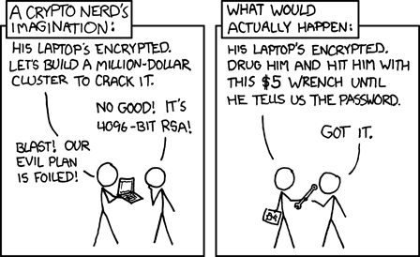
Drawbacks of (Just) Encryption II
JAIL
SUBPEONA
Notes:
Rule #1: don’t get caught. But when you do, you want to have deniability
Hard disk encryption, but…could get beaten by a rubber hose until you reveal all the passphrases to all known partitions.
Technical solution

Slide 28
Casual Conversations
Alice and Bob talk in a room
No one else can hear
Unless being recorded
No one else knows what they say
Unless Alice or Bob tell them
No one can prove what was said
Not even Alice or Bob
These conversations are “off-the-record”
Notes:
https://otr.cypherpunks.ca/otr-codecon.pdf

Slide 29
Desirable communication properties
Forward secrecy:
Even if your key material is compromised, past messages should be safe
Deniability: be able to deny having sent a message
Mimic casual, off-the-record conversations
Deniable authentication: be confident of who you are talking to, but unable to prove to a third party what was said

Slide 30
Off-the-Record (OTR) Messaging
1. Use Authenticated Diffie-Hellman to establish a (short-lived) session key EK
Sign_{alice}(g^{x})
Alice
Bob
Sign_{bob}(g^{y})
SS = (g^{y})^{x}
SS = (g^{x}) ^{y}
EK = H(SS)
EK = H(SS)
Notes:
-Here we use long-term keys only to authenticate the DH protocol messages
-The session key we establish will be short-lived; must be securely erased after use
Old:
Motivation: Alice and Bob want to communicate securely online (say via chat)
They share public PGP keys, and encrypt everything you send with other party’s public key, sign it with your private key.
Problem? PGP keys revealed; previously logged encrypted traffic now serves as cryptographic PROOF of content/authorship
Want: conversations to be validated, but after they are done, no proof (even from receivers!) that it happened.

Slide 31
OTR II
2. Then use secret-key encryption on message M
... And authenticate using a MAC
E_{EK}(M) MAC_{MK}(E_{EK}(M))
Alice
Bob
SS = (g^{y})^{x}
SS = (g^{x}) ^{y}
EK = H(SS)
EK = H(SS)
MK = H(EK)
MK = H(EK)
Notes:
-Recall the difference between digital signatures and MACs
-Where does the deniability come from? How deniable is the conversation, really?
Motivation: Alice and Bob want to communicate securely online (say via chat)
They share public PGP keys, and encrypt everything you send with other party’s public key, sign it with your private key.
Problem? PGP keys revealed; previously logged encrypted traffic now serves as cryptographic PROOF of content/authorship
Want: conversations to be validated, but after they are done, no proof (even from receivers!) that it happened.

Slide 32
Off-the-Record
3. Re-key using Diffie-Hellman
g^{x’}, MAC_{MK}(g^{x’})
Alice
Bob
g^{y’}, MAC_{MK}(g^{y’})
SS’ = (g^{y’})^{x’}
SS’ = (g^{x’}) ^{y’}
EK’ = H(SS’)
EK’ = H(SS’)
MK’ = H(EK’)
MK’ = H(EK’)
MK = H(EK)
MK = H(EK)
Notes:
Motivation: Alice and Bob want to communicate securely online (say via chat)
They share public PGP keys, and encrypt everything you send with other party’s public key, sign it with your private key.
Problem? PGP keys revealed; previously logged encrypted traffic now serves as cryptographic PROOF of content/authorship
Want: conversations to be validated, but after they are done, no proof (even from receivers!) that it happened.

Slide 33
Off-the-Record
4. Publish old MK
MK
Alice
Bob
SS’ = (g^{y’})^{x’}
SS’ = (g^{x’}) ^{y’}
EK’ = H(SS’)
EK’ = H(SS’)
MK’ = H(EK’)
MK’ = H(EK’)
MK = H(EK)
MK = H(EK)
Notes:
What does this gain you?

Slide 34
Off-the-record Messaging (OTR)
Note this is suited to interactive communication, not so much email
But, OTR provides
message confidentiality
authentication
perfect forward secrecy
deniability
Notes:
-make sure they understand 3rd parties can now forge transcripts of old conversations

Slide 35
Using OTR
Built in to Adium and Pidgin
But beware defaults
Logging enabled by default
Etiquette dictates you should disable this, so does history (e.g., Chelsea Manning)
☺ optional exercise: create an account on jabber.ccc.de, install OTR and verify a buddy. You may also want to run it over Tor.

Slide 36
Anonymity for browsing?
You
Server
Notes:
Lots of bad anonymity out there: let’s show some examples!

Slide 37

Naive approach .... VPNs
You
Server
Notes:
Technical problems:
-VPNs generally not designed with anonymity in mind (e.g., ability to work remotely and connect to corporate networks)
-Even a single leaked DNS requst or TCP SYN can identify user, but this might be OK for original purpose of VPN
-using a single browser for both anonymous and non-anonymous browsing -→ e.g., leaked cookies
-browser fingerprinting can uniquely identify you
Non-tech prob:
-You have to trust the VPN completely.
One single point of failure with full visibility into your metadata (and, if you are using e2e with destination, content)

Slide 38
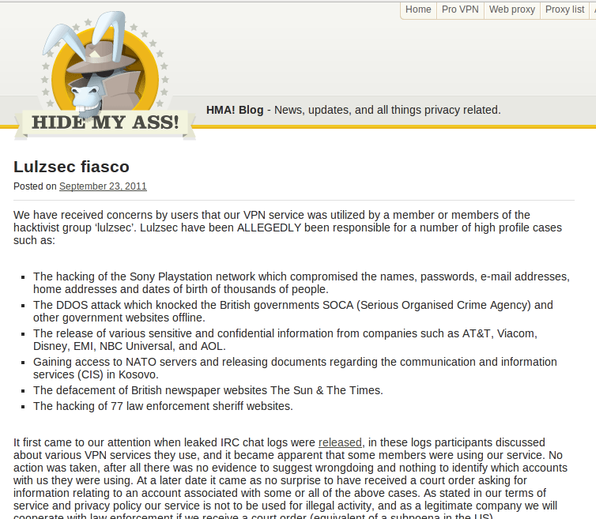
VPNs

Slide 39
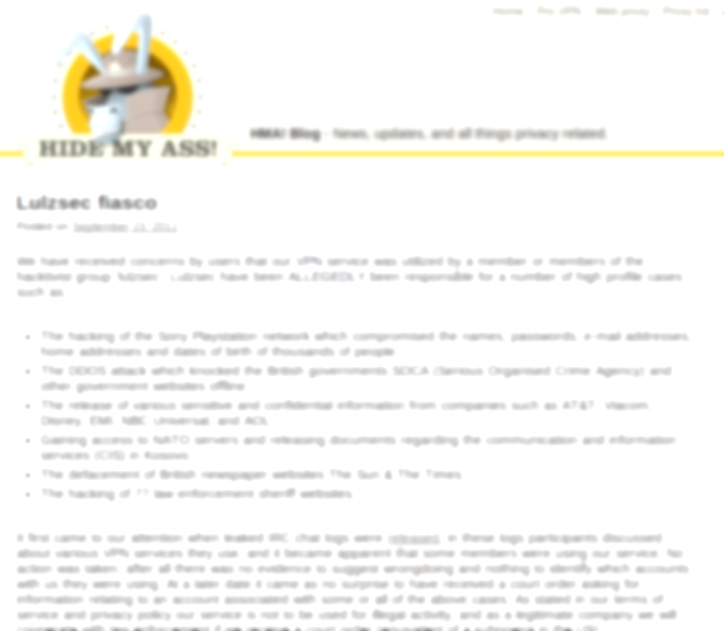
VPNs
“…received a court order asking for information relating to an account associated with some or all of the above cases. As stated in our terms of service and privacy policy our service is not to be used for illegal activity, and as a legitimate company we will cooperate with law enforcement if we receive a court order”
Notes:
Not that hidemyass.com is doing anything wrong here – they are simply complying with the local laws (otherwise THEY get shut down or go to jail). But it shows it’s not a great technical solution for anonymity, as it ultimately trusts the government.

Slide 40
Better approach: Tor
Low-latency anonymous communication system
Hide metadata
who is communicating with whom?
e.g., just sending an encrypted message to The Intercept may get you in trouble
Hide existence of communication
any encrypted message may get you in trouble

Slide 41
Tor overview
Works at the transport layer
Allows you to make TCP connections without revealing your IP address
Popular for web connections
Tor network made up of volunteer-run nodes, or onion routers, located all over the world
Basic idea: Alice wants to connect to a web server without revealing her IP address

Slide 42
Onion Routing
This approach generalizes to an arbitrary number of intermediaries (“mixes”)
Alice ultimately wants to talk to Bob, with the help of HMA, Dan, and Charlie
As long as any of the mixes is honest, no one can link Alice with Bob

Slide 43
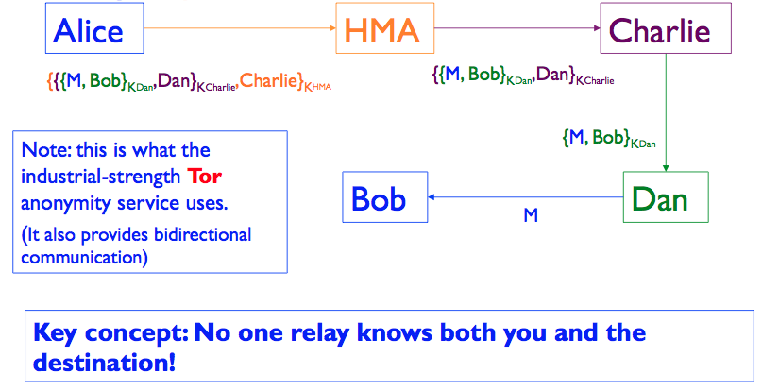
Onion Routing

Slide 44
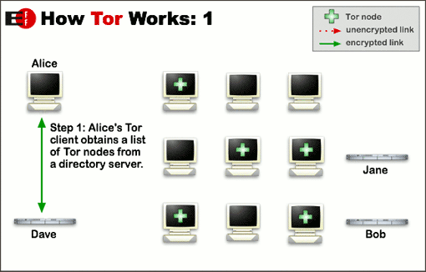
Tor
Image credit:
Tor Project
Notes:
-low-latency anon. communication systems
-works at the transport layer, has hundreds of thousands of users.

Slide 45
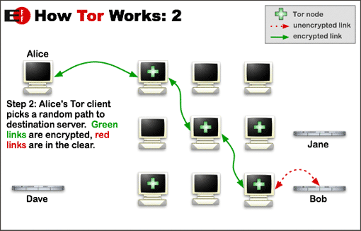
Tor
Image credit:
Tor Project

Slide 46
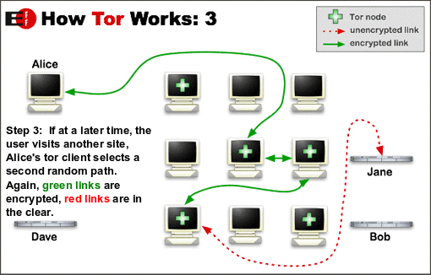
Tor
Image credit:
Tor Project

Slide 47
Trust in Tor
Entry node: knows Alice is using Tor, and identity of middle node, but not destination
Exit node: knows some Tor user is connecting to destination, but doesn't know which user
Destination: knows a Tor user is connecting to it via the exit node
Important to note that Tor does not provide encryption between exit and destination! (e.g., use HTTPS)

Slide 48
How to get Tor
Tor Browser bundle available (built on modified version of firefox)
☺ optional exercise: download and use it!
https://www.torproject.org/
...or volunteer to be a part of the Tor network.

Slide 49
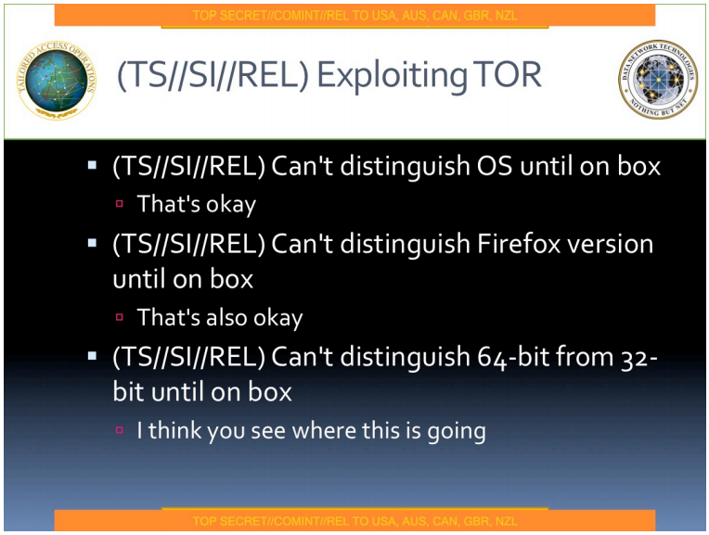
Egotistical Giraffe
Notes:
Oct 5 2013

Slide 50
Onion Routing Issues/Attacks?
Performance: message bounces around a lot
Attack: rubber-hose cryptanalysis of mix operators
Defense: use mix servers in different countries
Attack: adversary operates all of the mixes
Defense: have lots of mix servers (Tor today: ~2,000)
Attack: adversary observes when Alice sends and when Bob receives, links the two together
A side channel attack – exploits timing information
Defenses: pad messages, introduce significant delays
Tor does the former, but notes that it’s not enough for defense

Slide 51
Onion Routing Issues, cont.
Issue: traffic leakage
Suppose all of your HTTP/HTTPS traffic goes through Tor, but the rest of your traffic doesn’t
How might the operator of sensitive.com
deanonymize your web session to their server?

Slide 52
The traffic leakage problem
Answer: they inspect the logs of their DNS server to see who looked up sensitive.com just before your connection to their web server arrived
Hard, general problem: anonymity often at risk when adversary can correlate separate sources of information

Slide 53
Metadata
If
When
How much
Who
What

Slide 54
Metadata
If
When
How much
Who
What ← TLS/PGP

Slide 55

Metadata
If
When
How much
Who ←
What ← TLS/PGP

Slide 56
Pond
"Pond is not email. Pond is a forward secure, asychronous messaging system for the discerning"
Seeks to protect against leaking traffic info against all but a global passive adversary
forward secure
no spam
messages expire automatically after a week

Slide 57


Pond
Private Key
Public Key
Pond Server
User
Messages? Pubkey=A padding=XXXX..
None. padding=XXXXXXXXXXXXX…
Messages? Pubkey=A padding=XXXX..
Message=M padding=XXXXXXXXX…
Notes:
-connect to servers over Tor to hide which servers users are connecting to; i.e. Pond server is a Tor hidden service.
-all messaged are padded to 16KB to keep traffic profile constant
-users connect periodically (according to exponential distribution) to send and receive messages
-sending/receiving messages should look like randomly timed connections over Tor with identical traffic profiles
-Message encryption is similar to OTR protocol (but with important differences to prevent info leakage)
-spam avoided through use of group signatures (for a server to deliver a message to a user, the message must be signed by the user's group, but unclear which member of group did the signing)
-lots more details left out ....

Slide 58

Pond
Private Key
Public Key
Pond Server
User
Messages? Pubkey=A padding=XXXX..
None. padding=XXXXXXXXXXXXX…
Messages? Pubkey=A padding=XXXX..
Message=M padding=XXXXXXXXX…
Private key

Slide 59

Metadata summary
If
When ←
How much ←
Who ←
What ← TLS/PGP
Pond

Slide 60
Extra...
Optional exercises. Play with the following:
Tor Browser bundle
GnuPG
OTR on pidgin (or adium)
Pond ...
highly recommend using the CLI for pond
make a contact over Pond using a human memorable secret, as in the PANDA protocol...

Slide 61
Other Tools
From WhisperSystems https://whispersystems.org/)
For Android: RedPhone, TextSecure
For iOS: Signal
(compatible with RedPhone, a texting app is on
the way)

